Slide 1


Spotify Song's Time on Top Charts
Chloe Adams, Cal Bruno, Alex Theilen, and Vivienne Nalevanko

Slide 2
Executive Summary
Problem
What are the factors that affect a song’s length of time on Spotify top charts? This analysis is beneficial because it can help artists understand what variables of their song need improvement or changing to maximize the number of weeks on top charts and ultimately their revenue.
Data Source
Spotify Top Chart Songs 2022 dataset from Kaggle for our analysis.
Multi-linear regression model, collinearity, and residual plots
Methods
Measures
Variables, p-values of variables, multicollinearity/correlation
Conclusions
Most significant variable was Energy, with a negative relationship. The least significant was Peak Rank, also a negative relationship. Peak rank, Energy, Loudness, and Speechiness are all significant in predicting a songs time on Spotify.

Slide 3
Problem Statement- What Are We Trying to Solve?
English Problem statement:
Further Questions::
Which factor has the greatest impact on a songs time on the top charts of Spotify?
Which factor has the least impact on a song’s time on the top charts of Spotify?
What affects the length of time a song is on Spotify Top Charts?
What factors are significant in predicting a song’s time on Spotify Top Charts?
Big Analytical Question:::

Slide 4
Problem Statement- How Are We Going To Solve It?
Independent Variable: Time on Spotify Top Charts in weeks
Dependent Variables: Peak rank, Energy, Loudness, Speechiness, Acousticness, Duration, Tempo and Liveness
Strategy: Develop a multi-variable regression model to estimate the weeks a song will be on Spotify’s Top Charts.

Slide 5
Problem Statement- What Are Our Assumptions?
All the songs used are from the year 2022 and are on a global scale
Energy, loudness, speechiness, acousticness, liveness, tempo, peak rank, and duration are the only variables used in our analysis
We exclusively used data retrieved from the Kaggle dataset
The Kaggle dataset collected its data from Spotify Charts Global
We used a significant level of 0.05 as our alpha
The streams on Spotify are counted under the following assumptions: the songs have been listened to for more than 30 seconds, the count of streams begins from the release of the song on Spotify, and the users must be online for the stream to count (users offline such as on airplanes or without service will not have their listening amounts of songs recorded).
Peak rank and Weeks on Spotify Charts are reliant on number of streams

Slide 6


Data
646 Rows
645 Observations
1 Row for Labels
17 Columns
17 variables describing the songs
We utilized 9 of the variables provided
8 independent variables
1 dependent variable

Slide 7
Data Continued
Multivariable Regression
Dependent Variable- Weeks on Spotify's Top Charts
Independent Variable- Energy, Loudness, Speechiness, Acousticness, Liveness, Tempo, Peak Rank, and Duration
We chose the eight variables we thought would be the most significant in determining a song's tenure on Spotify's top charts.
Hypothesis
Alpha=0.05
Ho= The coefficient of the independent variables equal zero and therefore do not have any impact on a song's length of time on Spotify's top charts.
Ha= The coefficients of the independent variables do not equal zero and therefore have an impact on a song's length of time on Spotify's top charts.

Slide 8
Definitions Provided of Variables
Energy: Energy is a measure from 0.0 to 1.0 and represents a measure of intensity and activity. Typically, energetic tracks feel fast, loud, and noisy.
Loudness: The overall loudness of a track in decibels (dB). Loudness values are averaged across the entire track and are useful for comparing loudness of tracks and values typically range between -60 and 0 db with -60 being the loudest.
Speechiness: Speechiness detects the presence of spoken words in a track. The more exclusively speech-like the recording, the closer to 1.0 the attribute value.
Acousticness: A confidence measure from 0.0 to 1.0 of whether the track is acoustic. 1.0 represents high confidence the track is acoustic.
Liveness: Detects the presence of an audience in the recording. Higher liveness values represent an increased probability that the track was performed live.
Tempo: The overall estimated tempo of a track in beats per minute (BPM).
Duration: The duration of the track in milliseconds.
Peak Rank: The top rank a song reaches in the Spotify Top Charts ranging from 1 to 200 with 1 being the highest ranking.

Slide 9
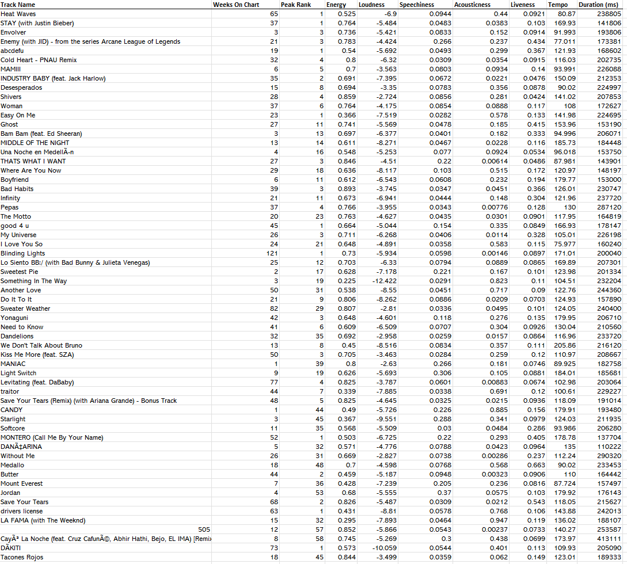
Methodology: Data Preparation
Data preparation
Downloaded Excel File
Changed column titles to enhance readability
Moved Week on Chart variable to inside column for easier analysis
Removed unnecessary data
Chose eight variables we thought would have the greatest impact on a song's time on Spotify's top charts
Removed URL, Danceability, Key, Mode, Instrumentalness, Artist & Time signature

Slide 10
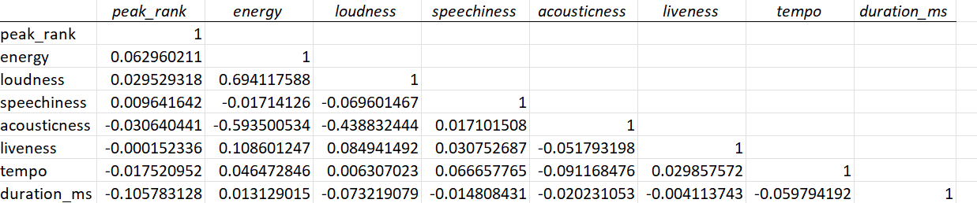
Methodology: Multicollinearity
Notes:
This is important because oftentimes independent variables are correlated which creates problems like incorrect coefficient signs in the model.

Slide 11
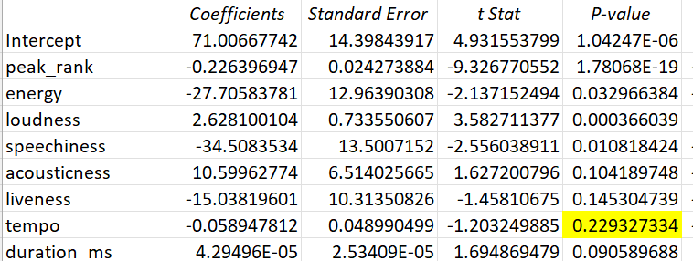
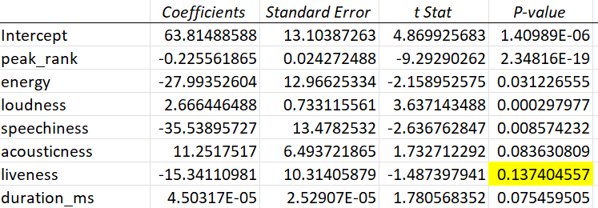
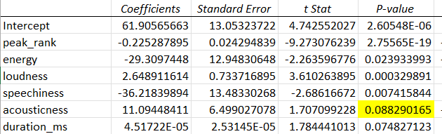
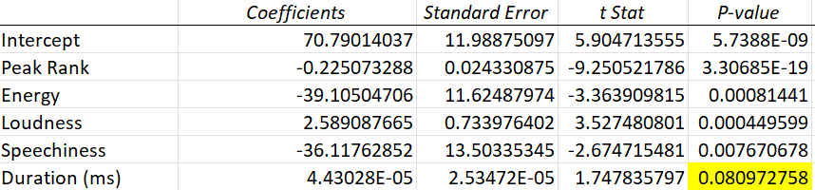
Methodology: Removing High p-values
We removed the following variables because their p-values were greater than alpha of 0.05:
Tempo
Liveness
Acousticness
Duration

Slide 12
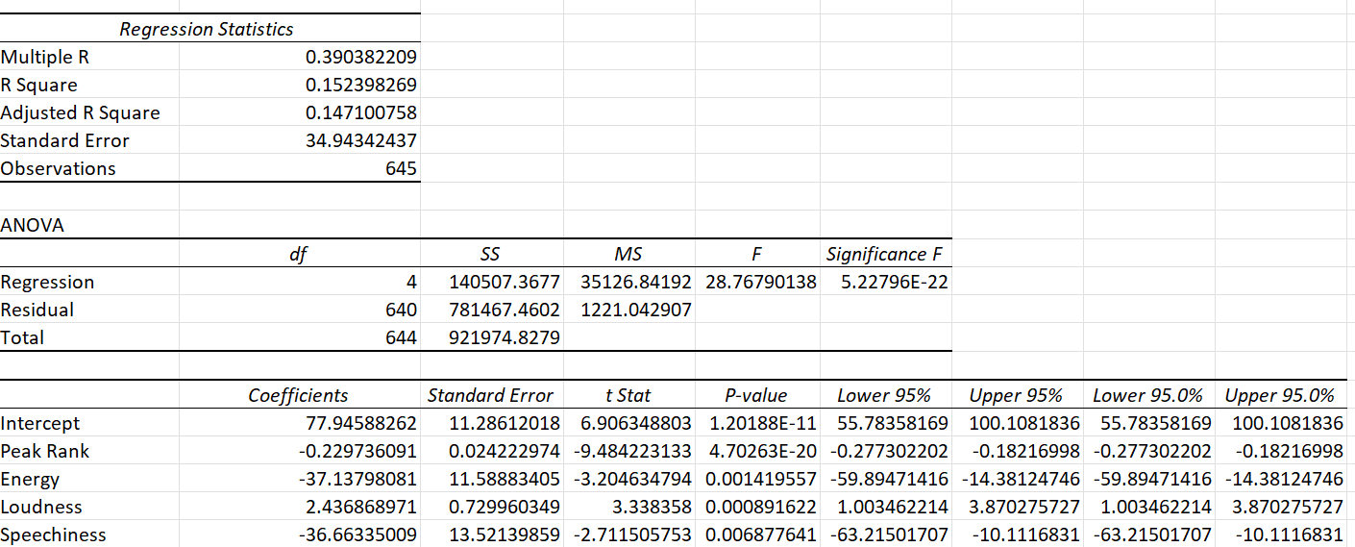
Final Regression

Slide 13
Methodology: Residual Plots

Slide 14
Final Model
Weeks on Spotify Top Charts= 77.95 - 0.23A - 37.14B + 2.44C -36.66D
C= Loudness
D= Speechiness
A= Peak Rank
B= Energy

Slide 15

Conclusion
In the beginning, we started off with 8 variables – Energy, Loudness, Speechiness, Acousticness, Liveness, Tempo, Peak Rank, and Duration
We took out four variables due to their high p-values: tempo, acousticness, liveness, and duration
We ran a final regression and found the most significant and least significant variables.

Slide 16
Conclusion Continued
The least significant variable would be Peak Rank, since it has the smallest coefficient. Peak Rank also has a negative coefficient meaning as it goes up (the lower ranked the song), time on charts go down, i.e., a negative relationship.
The most significant variable would be Energy as it has the highest coefficient, however, as Energy rises, amount of time on top charts falls. Therefore, Energy is the most significant, but it holds a negative relationship with length of time on top charts.

Slide 17
Works Cited
Kaggle. (2022). Spotify top chart songs 2022. Kaggle: Your Machine Learning and Data Science Community. https://www.kaggle.com/datasets/sveta151/spotify-top-chart-songs-2022
Dataset:
https://1drv.ms/x/s!AlMnh3uN5K2omR4THt50WpAGKG1g?e=i9JPXJ

